Slide 1

Emergency Management Plan Executive Briefing 2018
June 6, 2018

Slide 2
Overview
UTHealth EMP congruency with National Incident Management System (NIMS)
Brief description of major EMP elements
Two Examples (based on risk assessment)
Bomb threat
Inclement weather (Hurricane/Flooding)
Business Continuity Plan

Slide 3
National Incident Management System (NIMS)
NIMS – Federally required comprehensive national approach, applicable at all jurisdictional levels and across functional disciplines for responding to emergencies
NIMS training required for emergency responders and emergency management team (you)
NIMS required training is online
Courses: IS 700.a, 100.HE, 200.b, 800.b
http://training.fema.gov/IS/NIMS.asp

Slide 4
Emergency Management Scope
Prevention
Preparedness
Response
Recovery

Slide 5
Prevention
Routine surveillance
Lab, facility, and environmental safety surveys
System testing
Fire alarm and suppression systems, emergency generators, flood doors
Safety training
Lab safety training, Area Safety Liaisons, Facilities and Auxiliary Enterprises maintenance staff

Slide 6
Preparedness
Communication
Updated contact information
Institutional Awareness and Education
Emergency preparedness fliers
UTHealth website
Home preparedness kits
Drills
Fire drills
Flood door drill (May 5, 2018)
Hazardous material spill drills
Tabletop exercises

Slide 7
Key Units Involved with EMP
Environmental Health & Safety
EMP development, testing, emergency response for health and safety, training
Facilities, Planning & Engineering and Auxiliary Enterprises
Monitoring advisories, protecting property
UT Police
Monitoring advisories, initial emergency notifications, crowd and access controls
Public Affairs
Institutional and external communications
Information Technology
Computer systems

Slide 8
Emergency Management Plan Elements
Types of emergencies
Inclement weather
Fire
Hazardous material releases / theft
Facility failure
Bomb, cyber/terroristic threats of violence
Armed intruder
Auto accidents
Medical emergencies
Classified into “levels” for actions and notifications
Level 1 (area)
Level 2 (floor)
Level 3 (building)

Slide 9

FPE’s Work Control
Monitors Potential Emergency Situations & Informs VP FPE, and Answering Service
UTPD
Monitors Potential Emergency Situations & Alerts FPE’s Work Control
Emergency Notification
If after hours: Answering Service
Relays emergency event message
Environmental Health & Safety
Reports to the scene of an emergency, assist as required
CLAMC
Coordinates the needs of the University’s’ research animals
OPA Communications
Updates information resources & informs the Executive Team as necessary
UT Physicians
Coordinates UTP Personnel & Updates the Executive Team
VP of AE
Coordinates AE Personnel & Updates the Executive Team
VP of FPE
Coordinates FPE Personnel & Updates the Executive Team
Activate emergency advisories on Web home page
Notify answering service for main switch board
Update voice mail message at
713-500-9996 or 713-500-7999
Notify School Deans and Executive Council as appropriate
Notify/Update News Media
The decision to modify operations can be made by any of these individuals
Dr. Giuseppe Colasurdo
President
Dr. Michael Blackburn
Executive Vice President Research
Kevin Dillon
Sr Executive Vice President, Chief Operating and Financial Officer
Wes Stewart
VP of Facilities, Planning, & Engineering
Dr. Robert Emery
VP Environmental Health Safety and Risk Management
Chief William Adcox
UTPD Chief of Police

Slide 10
Emergency Communication Options
UTHealthALERT text messages for imminent threats
UTHealth intranet emergency banner
Targeted or mass email (note: inherent delay)
Web at www.uthealthemergency.org (offsite hosting backup)
Fire Alarm Control Panel voice announcement capability
Campus television monitors
Designated voicemail lines with informational messages (offsite toll free number backup)
Local television
Local radio
Facebook / Twitter

Slide 11
UTHealthALERT
UTHealthALERT text messages for imminent threats such as an active shooter or tornado or anytime there is a change in status and other situations
Enables one person to communicate very quickly with thousands of people anywhere and at anytime
Track broadcasts
When the message was sent
Who the message was sent to
Who confirmed receiving the message
Who hasn’t confirmed receiving the message
Who wasn’t able to be reached

Slide 12
Why only send text messages?
System is faster using only one method
Too many methods/messages can overwhelm regional, local, or internal communication systems
Almost everyone owns a cell phone and people tend to keep it with them when they are in transit
OPA can send a mass email

Slide 13
UTP Clinics
Each clinic has its own Emergency Management template/plan
Ambulatory loss prevention assessments
Looks for any hazard that can shut clinic down for a period of time
Patient, visitor hazards, injuries
Employee hazards, injuries

Slide 14
Controlled Access
UTHealth never “closes”
When initiated, controlled access engages essential personnel
Non-essential personnel may access facilities as deemed necessary by signing in and out at the building guard desk and being escorted while in the facility.

Slide 15
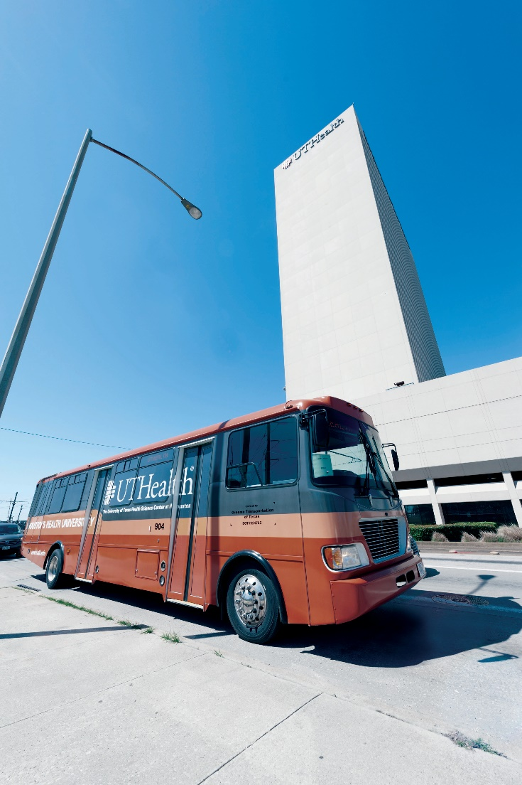
Example 1 Bomb, Cyber or Terroristic Threats of Violence

Slide 16
Typical Event
Threat called in, mailed in or submitted electronically (email, social media, etc.)
Key details of message should be noted, reported to UTPD
NOTE: specific training for key administrative available from UTPD
If threat is non-specific, experts suggest not evacuating, but to conduct low key sweep of building for suspicious items
If threat is specific (time, location, etc.) experts suggest evacuation, and subsequent sweep
Ultimate decision to evacuate rests with Executive Team, not UTPD

Slide 17
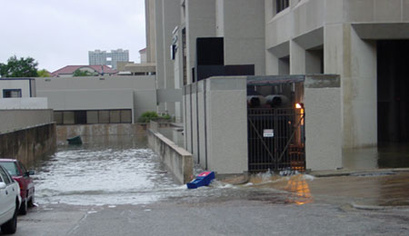
Example 2 Inclement Weather: Flooding or Hurricane

Slide 18

TMC Flood Alert System http://fas4.flood-alert.org
Green – Flooding possibility minimal to none
Yellow – “Flood Caution”
Flooding conditions possible.
10-20% chance of flooding
Orange – “Flooding Possible”
Water level high in Brays Bayou with heavy rains expected in the western portion of the watershed. 40-50% chance of flooding if storms persist.
Red – “Flooding Probable”
Water levels very high in Brays Bayou with heavy rains expected to continue in western portion of the watershed. 80-90% chance of flooding. Controlled Access requested, Executive Decision necessary.
Critically important: this color coding system is NOT synchronized with TMC weather alerts that are sent by text, e-mail

Slide 19
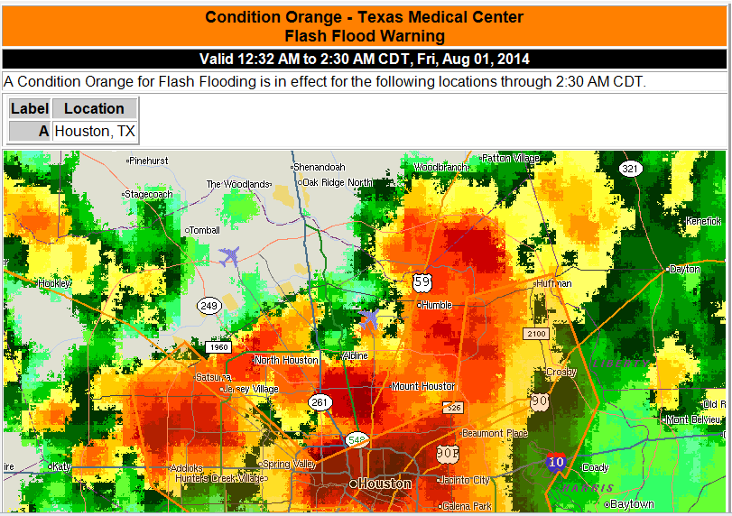
Critically important: this TMC weather color coding system is NOT synchronized with Flood Alert.org system our flood door plan is linked to

Slide 20
Hurricane Preparation Sequence
96 hours before landfall: preparations begin
72 hours: Alert status – preparations ramp up
48 hours: Watch status – final preparations
24 hours: Warning status – Ride out team arrives. Controlled Access requested, Executive Decision necessary.
8 hours out: warning status – controlled access

Slide 21
Business Continuity Plan
Designed to address business continuity issues up to 30 days post disaster in hopes of reducing the severity and duration of operational impacts
11 key units identified requiring detailed BCP plans
Template worksheets created for research, academic, clinical, and administrative departments
Rapid building damage assessment checklist developed

Slide 22
Recovery
Existing UT System pre-established contracts
Water, fire, smoke damage, etc. – BMS Catastrophe
Hazardous materials spills – Eagle Environmental
Hazardous waste disposal – Veolia, Stericycle
UTHealth Evergreen contracts & JOC
UT System mutual aid agreement
Property Insurance coverage
Fire and all other perils
Wind and named storms

Slide 23
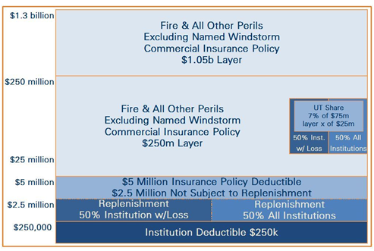
CPPP 2017-18 – FIRE & AOP STRUCTURE

Slide 24
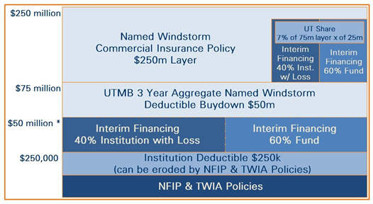
CPPP 2017-18 – NAMED WINDSTORM STRUCTURE

Slide 25
Summary
EMP sets out framework for institutional emergency response and management
Key executive decisions are typically:
Open or Controlled Access?
Evacuate or shelter in place?
Note that decisions can sometimes be impacted by local or state agency decisions
BCP facilitates institutional recovery
Focus on prevention and preparedness
Each emergency situation is different, but in every such event, cooperation and communications are key!

